Slide 1
Student Privacy
Who has access to your student data?
Brainstorm 2019
https://goo.gl/nixYRs

Slide 2
About Me
Technology Coordinator since 2013 at the Sioux Center CSD
Previously taught MS and HS math and computer courses
Previously worked as a DBA and MES Programmer
Contact Info:
brady.woudstra@scwarriors.org
Slides URL: https://goo.gl/nixYRs

Slide 3
About Sioux Center CSD
1400 students
3 Tech Staff
Averaging 50 new students per year for the last 5 years
1:1 with Chromebooks - TK-8th Grade, 10-12th Grade
1:1 with PCs - 9th Grade
Just passed a bond for a new High School opening in Summer 2021
Slides URL: https://goo.gl/nixYRs

Slide 4
Agenda
Why should we care about student data privacy?
Privacy Pledges
Data Loss Exposure Types
Apps Using School Credentials
Reports from G-Suite and Azure AD
Helpful Tools
Slides URL: https://goo.gl/nixYRs

Slide 5
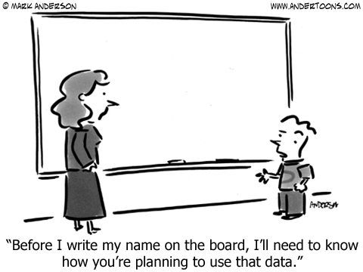

Slide 6
The Wild Wild West for Apps and Privacy
Can we get ahead of the curve?
Should be care?
What does FERPA or PPRA say?
What does COPPA say?
Slides URL: https://goo.gl/nixYRs

Slide 7
What are the risks?
FTC: “Many school forms require personal and, sometimes, sensitive information. Find out how your child’s information is collected, used, stored, and thrown away. Your child’s personal information is protected by law. Asking schools and other organizations to safeguard your child’s information can help minimize your child’s risk of identity theft.”
FERPA: Parent’s have a right to opt-out of 3rd party sharing that isn’t ‘Directory’ information.
Javelin Research: More than 1 million minors were victims of identity theft in 2017.
Slides URL: https://goo.gl/nixYRs
Notes:
Open the links and talk about them

Slide 8
What are the risks?
Identify Theft of our Students & Families
Personally Identifiable Data
Academic Data
Health Data
Ads and Usage Tracking (Longitudinal Data)
Slides URL: https://goo.gl/nixYRs
Notes:
Compare with healthcare industry
Examples on academic data
Examples on health data - health monitors

Slide 9
Resources and Examples
Common Sense Media Report
College Board Data - $0.45/name
Palo Alto HS - Infinite Campus breach
CPAP Machine Denial (Ars Technica)
NRP Health Data
Slides URL: https://goo.gl/nixYRs
Notes:
Compare with healthcare industry
Examples on academic data
Examples on health data - health monitors

Slide 10
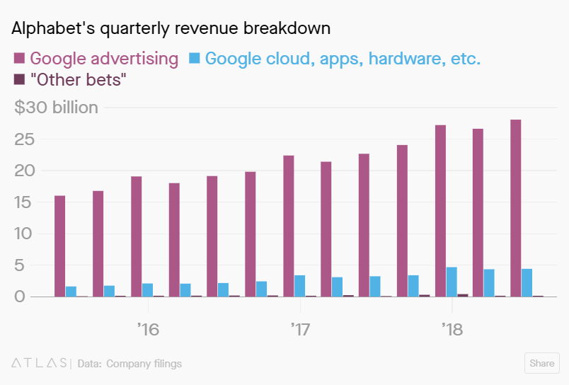
Alphabet (Google) Revenues - 86% from advertisements
Slides URL: https://goo.gl/nixYRs
Notes:
Compare with healthcare industry
Examples on academic data
Examples on health data - health monitors

Slide 11
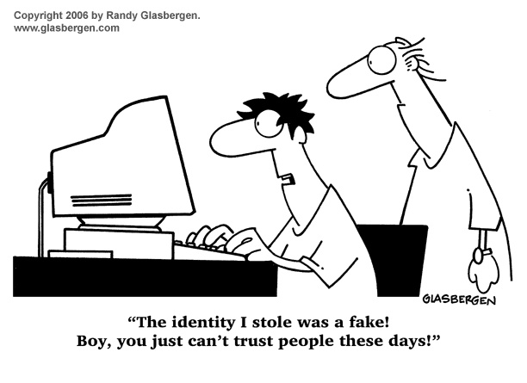

Slide 12
Existing Board Policies
409.1 - Media use by Staff
505.2 - Academic Records for Students
505.4 - Use of Directory Information
605.9 - Web Publishing
Slides URL: https://goo.gl/nixYRs

Slide 13
Student Privacy Pledges
Student Privacy Pledge - https://studentprivacypledge.org/
Kid Safe Seal - https://www.kidsafeseal.com
Other Resources:
https://ferpasherpa.org/
https://studentprivacy.ed.gov/
https://privacy.a4l.org
https://www.projunicorn.org/
Slides URL: https://goo.gl/nixYRs
Notes:
Open the links and talk about them
Not legally binding

Slide 14
Who should deal with this?
Who is reading the Terms of Service and EULA?
Curriculum Directors
Principals
Tech Staff
Always balancing CONVENIENCE and PRIVACY
Slides URL: https://goo.gl/nixYRs

Slide 15
Our District Digital Data Loss Basic Exposure Types
Low Probability
Medium Probability
High Probability
Local Data Center
Hosted Services (SIS, Accounting)
Student Credentials
Staff Credentials
Apps Sell our Data
Slides URL: https://goo.gl/nixYRs
Notes:
Our datacenter holds backups of our old JMC and SUI software.
IC has a lot of student/staff data. Including some SSN numbers.
SUI has ALL our current and past staff member data.
We use single sign-on which exposes us to some risk.

Slide 16
Some of Our District’s Apps
Google Services
Microsoft Services
IXL Study Island MobyMax Learning.com (EasyTech) A-Z Reading/RazKids Glogster WeVideo EpicBooks Infinite Campus
NWEA MAPs
SeeSaw Renaissance Learning (STAR and AR) Rosetta Stone EDUTyping SpheroEDU Summit Learning
Cengage
Aplia
Canvas
Destiny
rSchoolToday
Clever

Slide 17
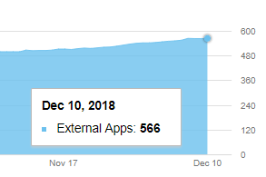
Total Applications Using School Credentials
Google Access (Android and Web Apps)
API Access to Google Services/Data
Gmail - 16 apps
Drive - 118 apps
Calendar - 8 apps
Contacts - 41 apps
Admin - 9 apps
Apps Scripts - 34 apps
Slides URL: https://goo.gl/nixYRs

Slide 18
Viewing OAuth Apps - G-Suite
https://admin.google.com/scwarriors.org/AdminHome?hl=en#Reports:subtab=security
https://admin.google.com/scwarriors.org/AdminHome?fral=1#SecuritySettings:flyout=oauth2scopemanagement
https://admin.google.com/scwarriors.org/AdminHome?fral=1#Oauth2ScopeManagement:subtab=installed
https://support.google.com/a/answer/2537800?hl=en
https://support.google.com/accounts/answer/3466521?hl=en
Slides URL: https://goo.gl/nixYRs

Slide 19
Viewing OAuth Apps - Azure AD
https://portal.azure.com/#blade/Microsoft_AAD_IAM/StartboardApplicationsMenuBlade/AllApps/menuId/
https://portal.azure.com/#blade/Microsoft_AAD_IAM/StartboardApplicationsMenuBlade/Audit/menuId/
https://docs.microsoft.com/en-us/azure/active-directory/develop/quickstart-v1-remove-azure-ad-app
Slides URL: https://goo.gl/nixYRs

Slide 20
Blocking Extensions & OAuth in G-Suite
Chrome for Enterprise ADMX Packages
Also available for macOS & Linux
Admin Console
Extensions
API Access - KB Article
Slides URL: https://goo.gl/nixYRs
Notes:
Also has info for Mac & Linux

Slide 21
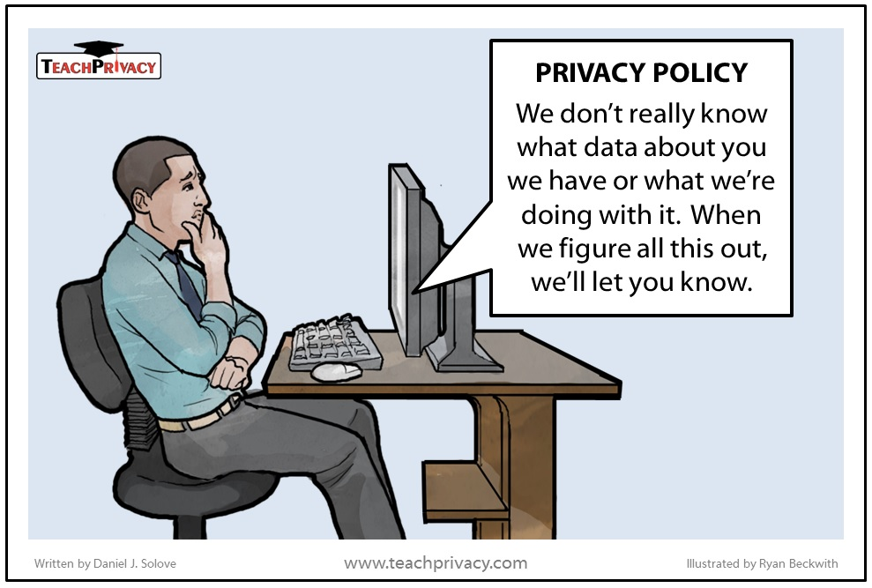

Slide 22
Examples
Bark for Schools - https://www.bark.us/
IXL - www.ixl.com
Assistant Devices - Alexa (Echo), Google Home, Siri, etc.
Slides URL: https://goo.gl/nixYRs

Slide 23
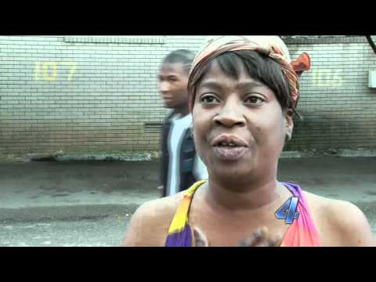
Recommendation A - Ain’t Nobody Got Time for That
#0 - Create a process for new software requests! Tech, Curriculum Director, Principal…
#1 - If it involves student data, is it connected to a privacy pledge?
#2 - Get parental approval

Slide 24
Recommendation B
#0 - Create a process for new software requests! Tech, Curriculum Director, Principal…
#1 - Assign SOMEONE to read EULA & ToS and approve all new software.
#2 - Only enter first names into non-OAuth enabled sites that require usernames and passwords
#3 - Get parent approval.

Slide 25
Recommendation C
#0 - Create a process! Requests go Tech, Curriculum Director, Principal...
#1 - Have multiple people read EULA & ToS (possibly your school lawyer).
#2 - Confirm what information about a student is collected (assume it will be shared or sold).
#3 - Get parental approval.

Slide 26
Recommendation C - Continued
#4 - Student accounts should only contain First Name and Last Initial along with a Graduation Year or Birth Year or another random number. bradyw293@example.com
#5 - Only enter first names into non-OAuth enabled sites that require usernames and passwords.
#6 - Differentiate between tools that require a log on and tools that don’t.
#7 - Free isn’t free. If it’s worth using, it’s worth paying for.

Slide 27
